Slide 1
Event Based Approaches
Oxford University
Software Engineering Programme
December 2019

Slide 2
Why Asynchronous?

Slide 3
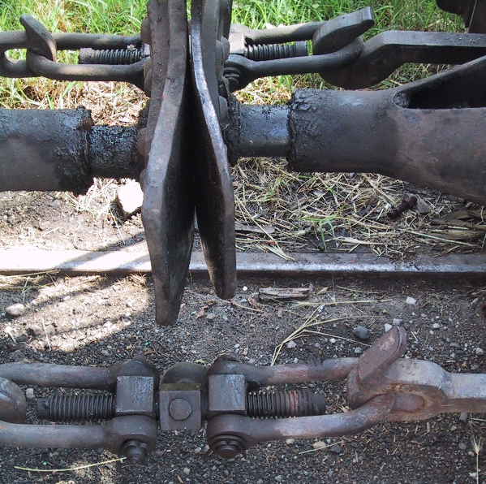
Loose coupling

Slide 4
Event Driven Architecture
Event Consumer
Event Producer
Event
Event Consumer

Slide 5
Loose coupling in EDA
Location
Logical addresses
Time
Asynchronous, Store/Forward, Replay
Message
JSON, XML, ProtoBuf, etc
Pattern
Pub/Sub, Queue, 1-1, 1-many, many-many, request-reply

Slide 6

EDA

Slide 7
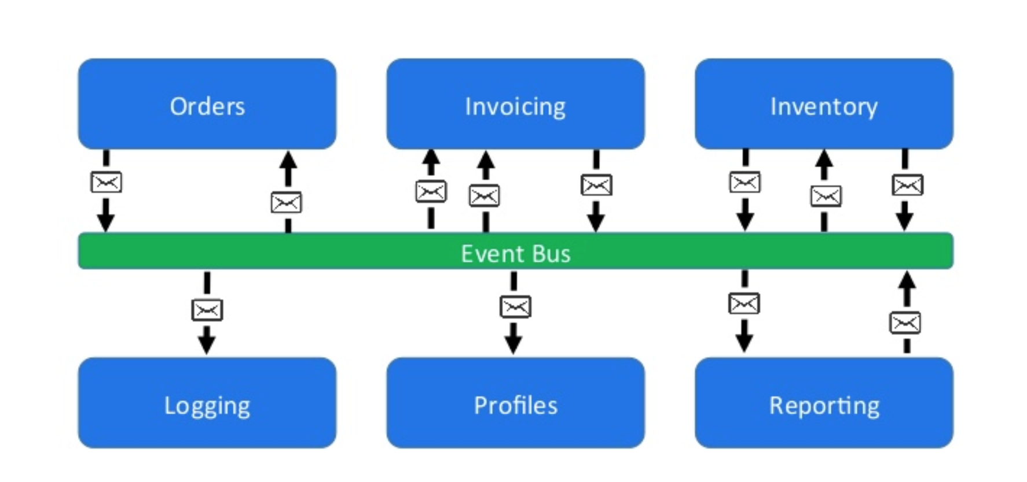
Loose coupling via event bus
https://www.slideshare.net/CentricConsulting/eventdriven-architecture-57613466

Slide 8
Event Sourcing
https://eventuate.io/whyeventsourcing.html

Slide 9
Message distribution systems
NATS
MQTT
STOMP
AMQP / RabbitMQ
Kafka

Slide 10
NATS
Simple text based protocol
Multiple patterns
Pure Pub/Sub
Request-Reply
Queuing
Clustered servers
Distributed queue across clusters
Cluster aware clients

Slide 11
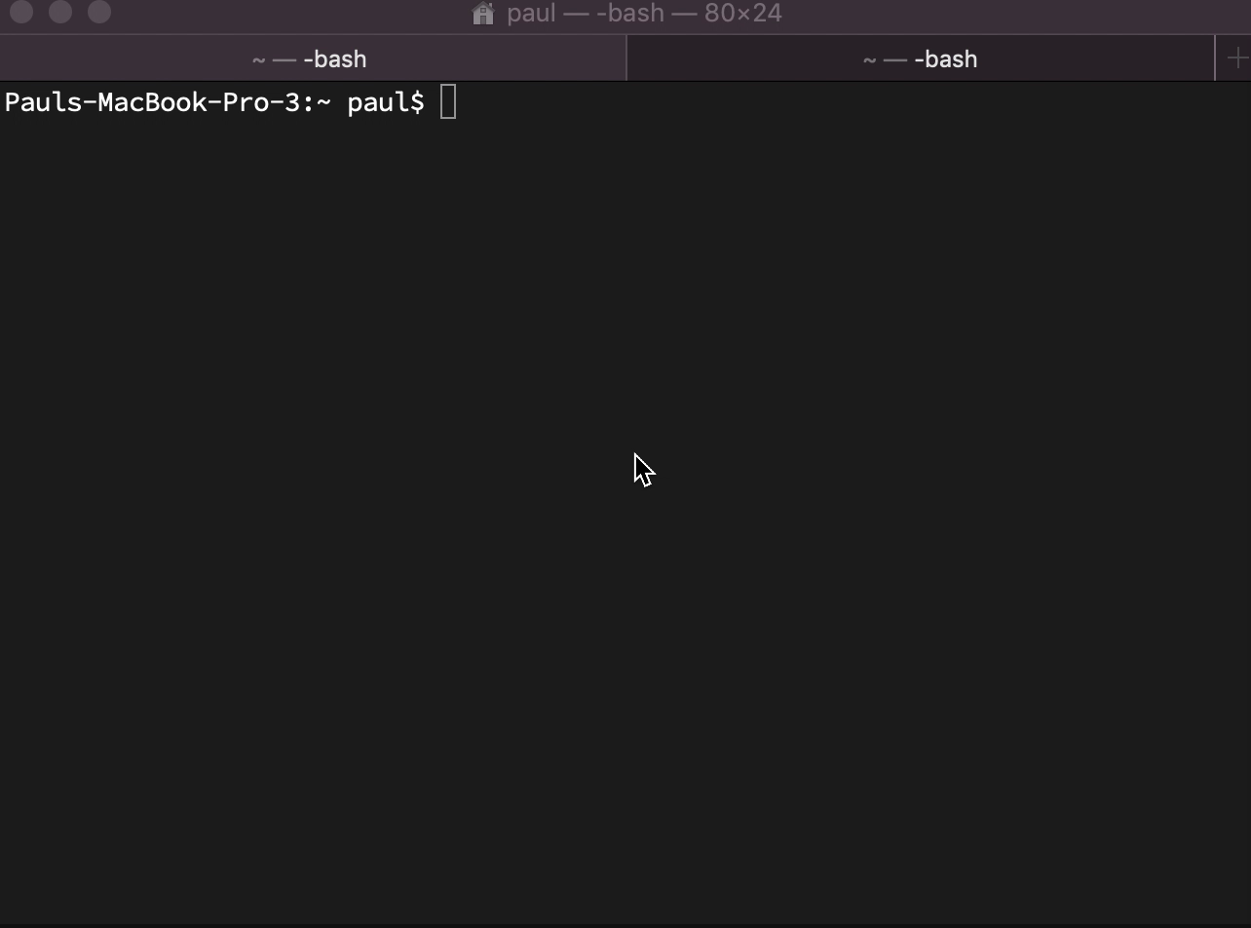
NATS simple demo

Slide 12
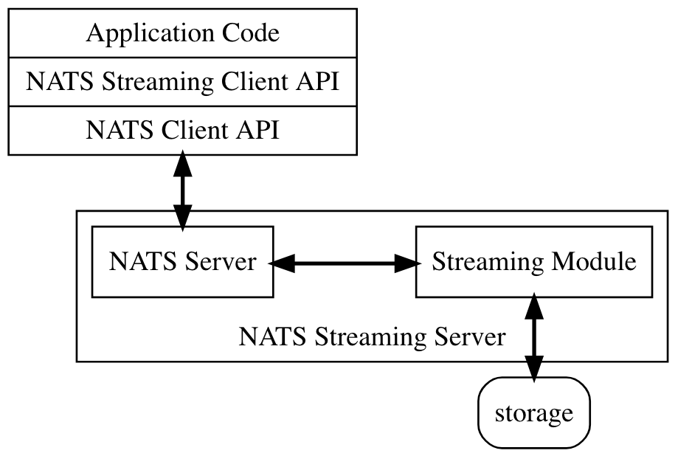
NATS Streaming

Slide 13
NATS Streaming
At least once delivery
Publisher rate limiting
Subscriber rate limiting
Message Replay
Durable Subscriptions

Slide 14
MQTT
Very lightweight binary protocol
2-byte overhead
Widely used in IoT scenarios
Pub-sub only until MQTT5
QoS levels
Fire and forget QoS0
At least once QoS1
Exactly once QoS2

Slide 15
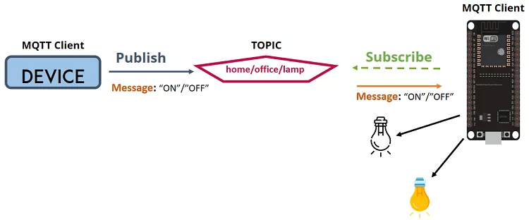
MQTT

Slide 16
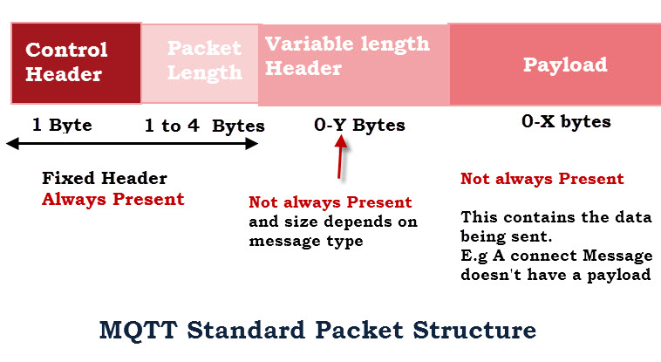
MQTT Packets http://www.steves-internet-guide.com/mqtt-protocol-messages-overview/

Slide 17
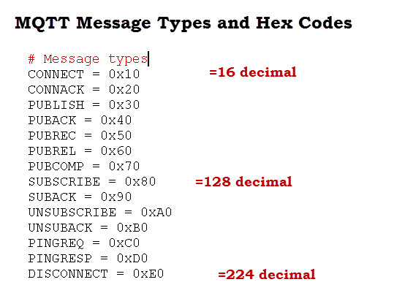

Slide 18
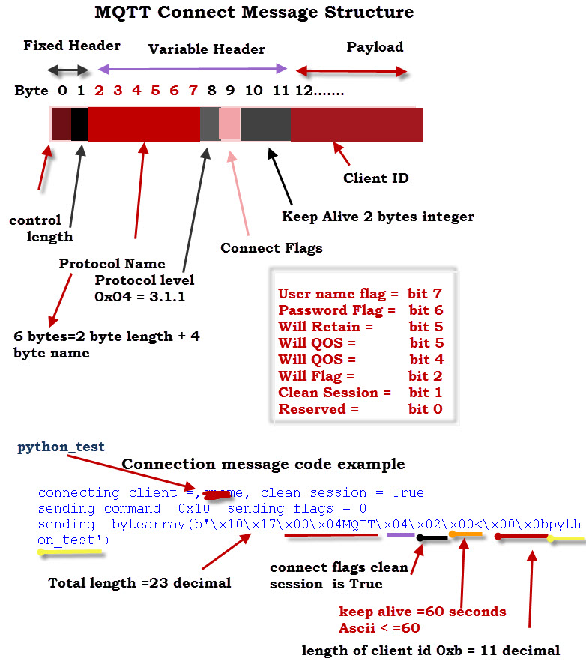

Slide 19
AMQP / RabbitMQ
AMQP is an advanced messaging protocol
Designed to meet more enterprise needs
Emerged from JP Morgan attempting to decouple from proprietary systems
Standardised in OASIS
Although many implementations prefer 0-91 to 1-00

Slide 20
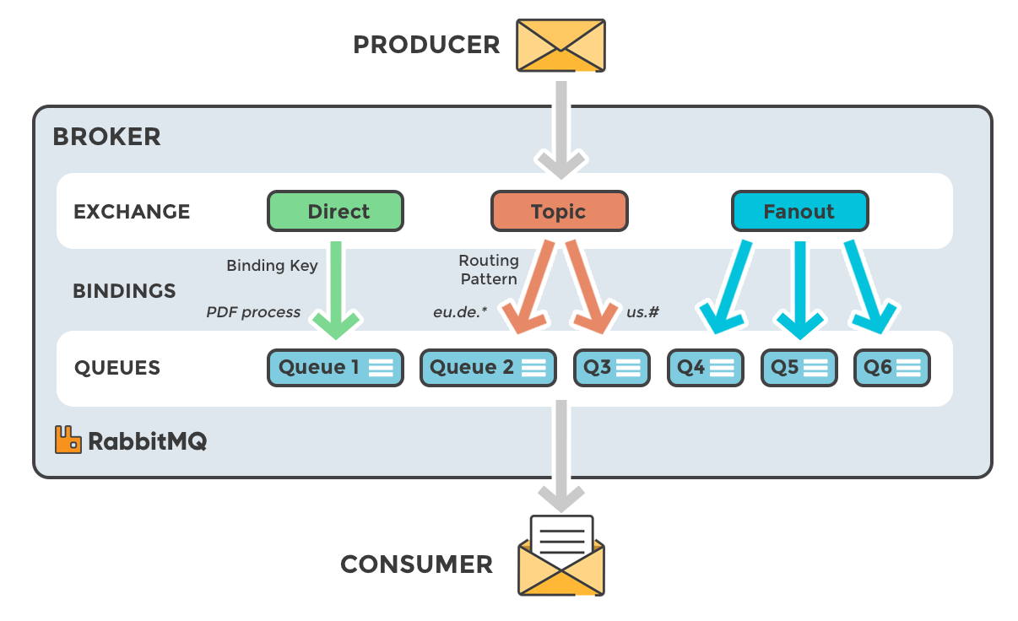

Slide 21
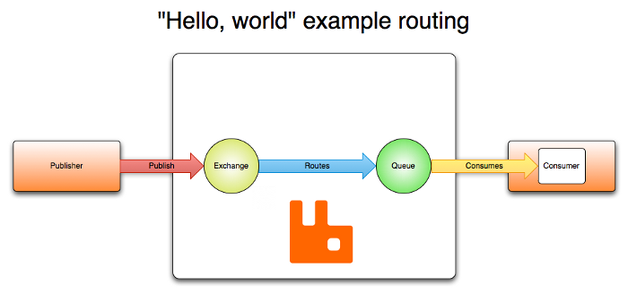
RabbitMQ

Slide 22
RabbitMQ
Written in Erlang
Designed to implement the AMQP 0-91 spec
Now extended to support STOMP, MQTT, AMQP 1-0 and HTTP
Clusterable and high-performance
Transactional

Slide 23
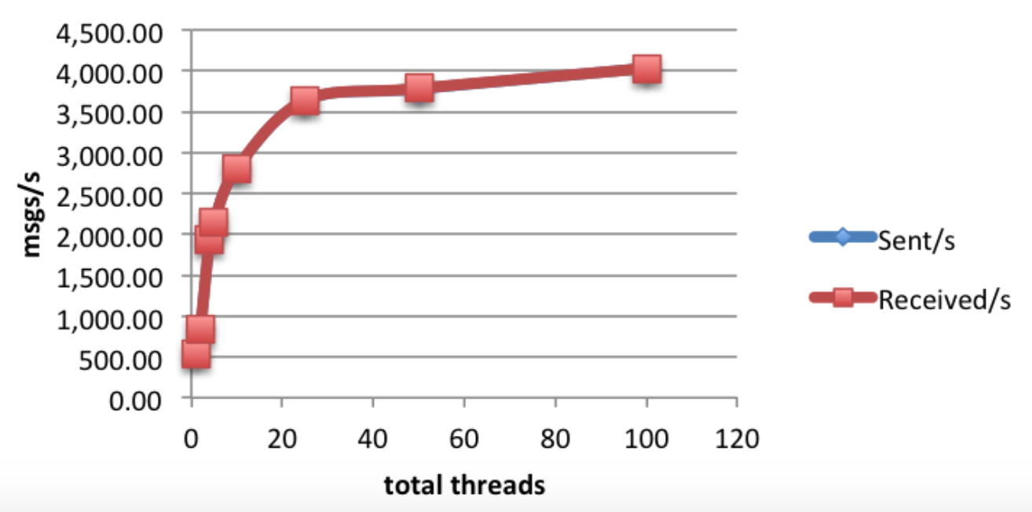
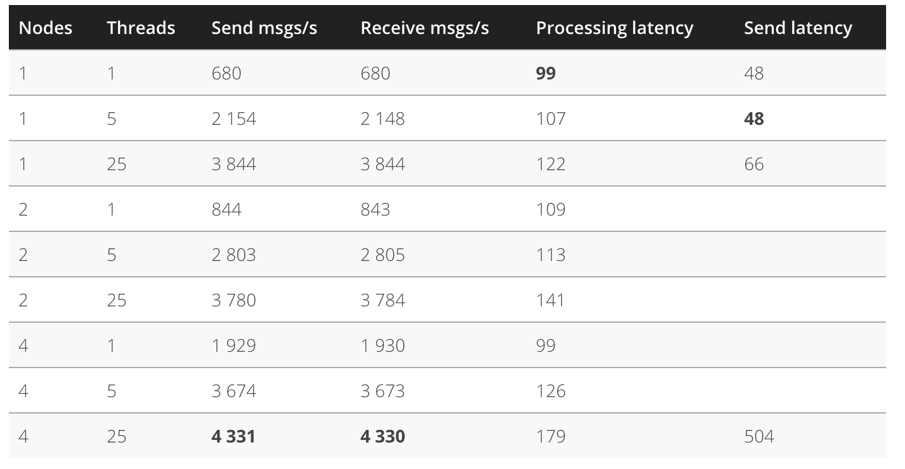
RabbitMQ performance https://softwaremill.com/mqperf/

Slide 24
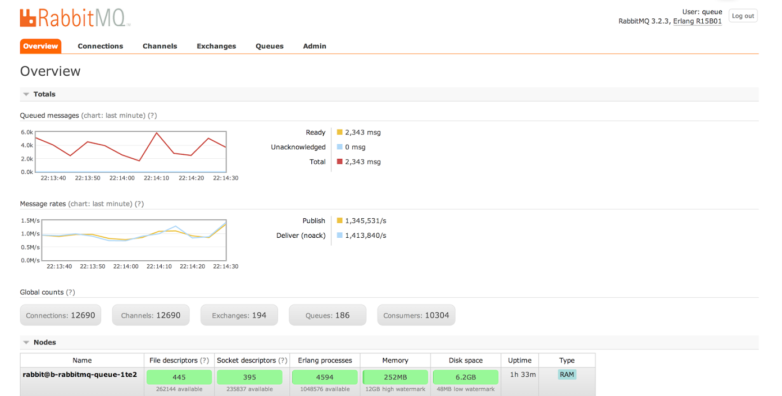
>1m msgs/sec https://content.pivotal.io/blog/rabbitmq-hits-one-million-messages-per-second-on-google-compute-engine

Slide 25
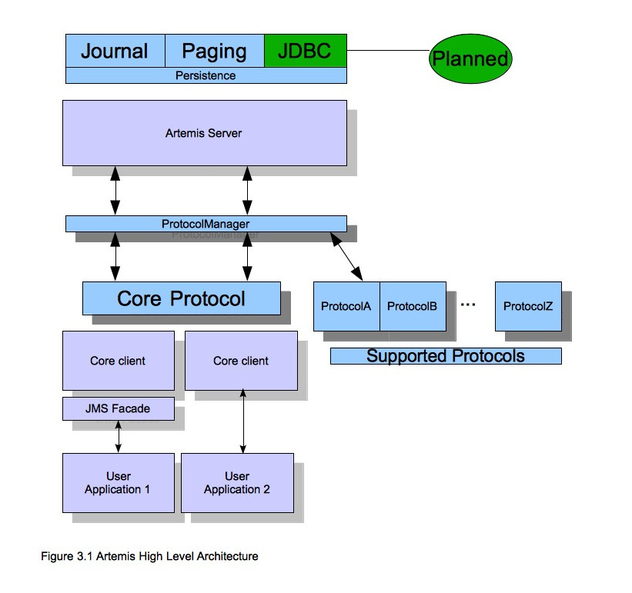
ActiveMQ / Artemis

Slide 26
Artemis
Supports multi-protocols:
“JMS”, AMQP, STOMP, OpenWire, MQTT, REST
Highly available and clusterable
Written in Java

Slide 27
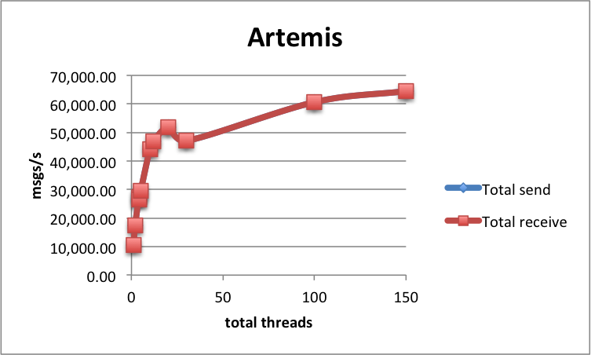
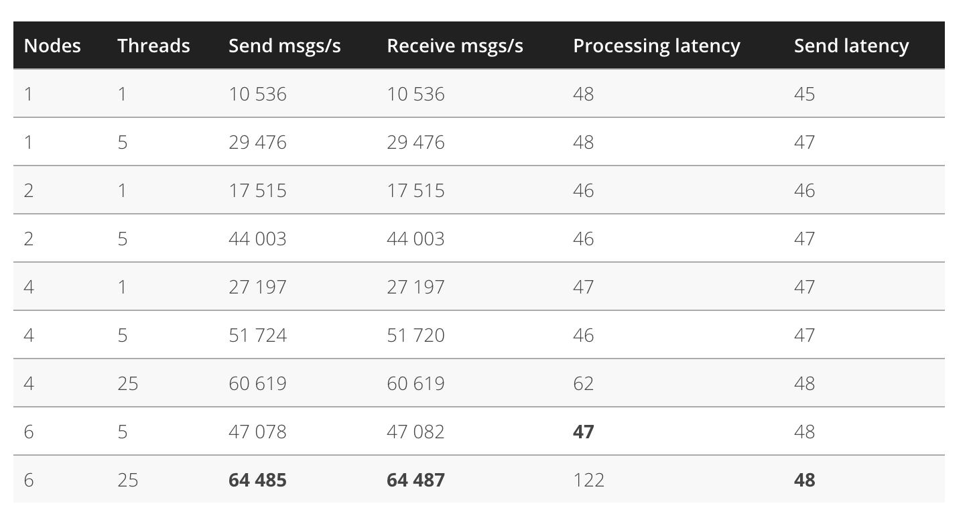
Artemis Performance https://softwaremill.com/mqperf/

Slide 28
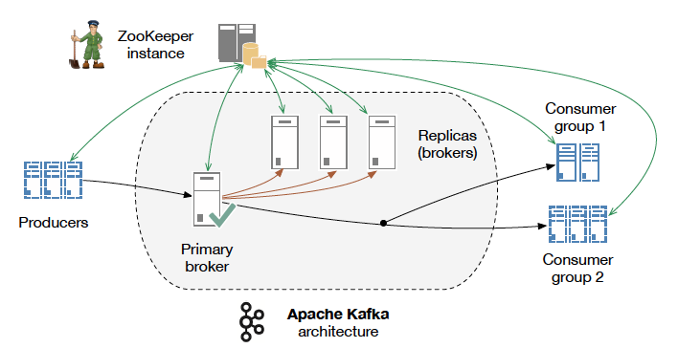
Apache Kafka

Slide 29

Apache Kafka
Source: http://www.slideshare.net/charmalloc/

Slide 30
Kafka
Applying “big data” approaches to messaging:
Partitioning
Multiple brokers
Elastically scalable
Supports clusters of co-ordinated consumers
Automatic re-election of leaders

Slide 31
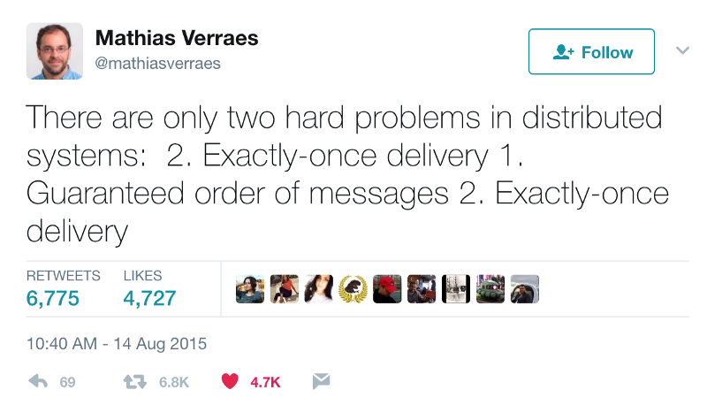
Kafka exactly-once semantics

Slide 32
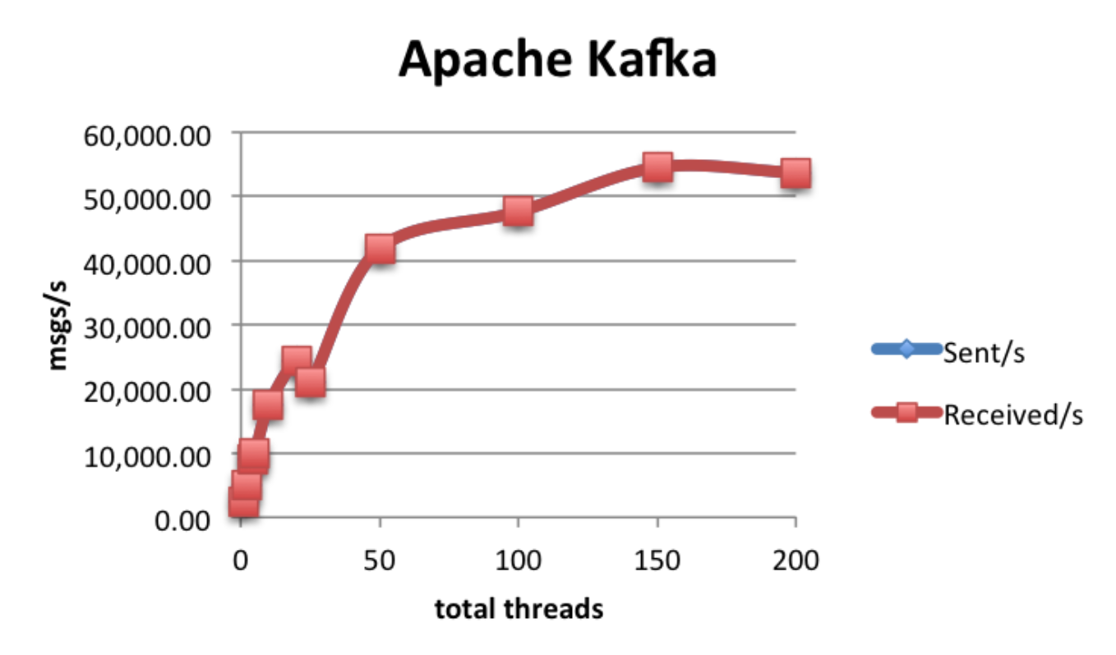
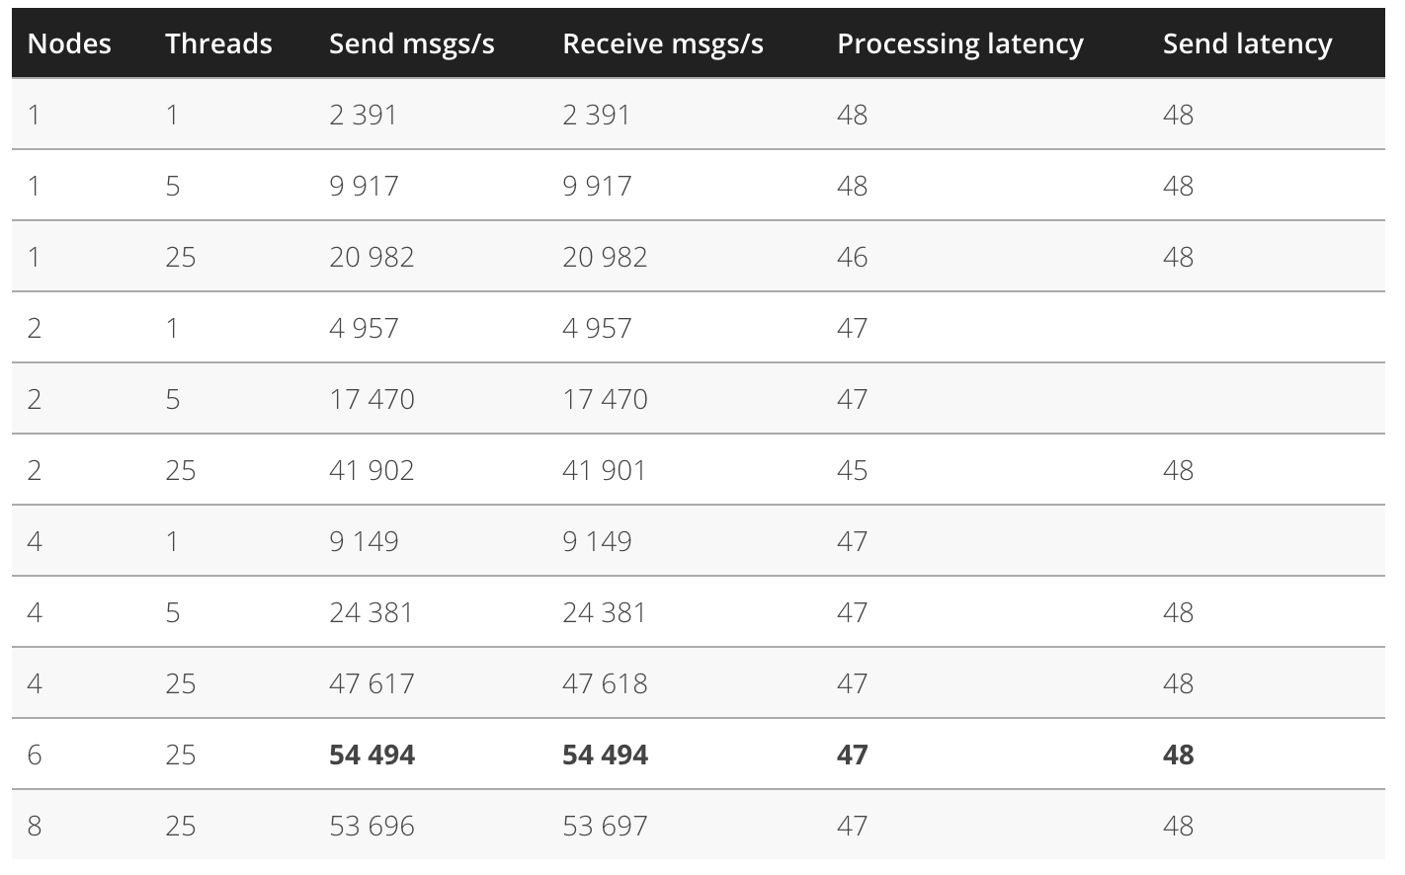
Kafka Performance

Slide 33
Questions?

